Slide 1

NoteVerse
Shubham singh (2002900130043 / IT)
Shahbaz ansari (2002900130039/ it)

Slide 2
Objective
Develop a highly efficient notes application that significantly enhances the user's day-to-day productivity and organization.
Efficient note making
Seamless Synchronization
Organization and Categories
Remainder

Slide 3
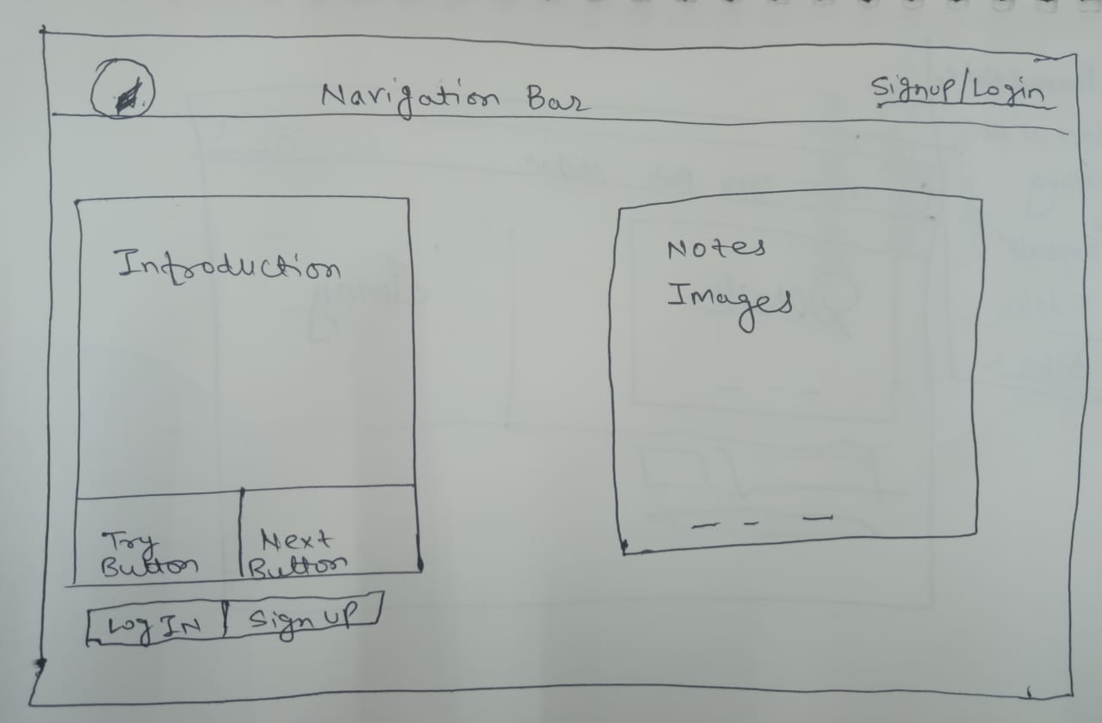
Layout

Slide 4
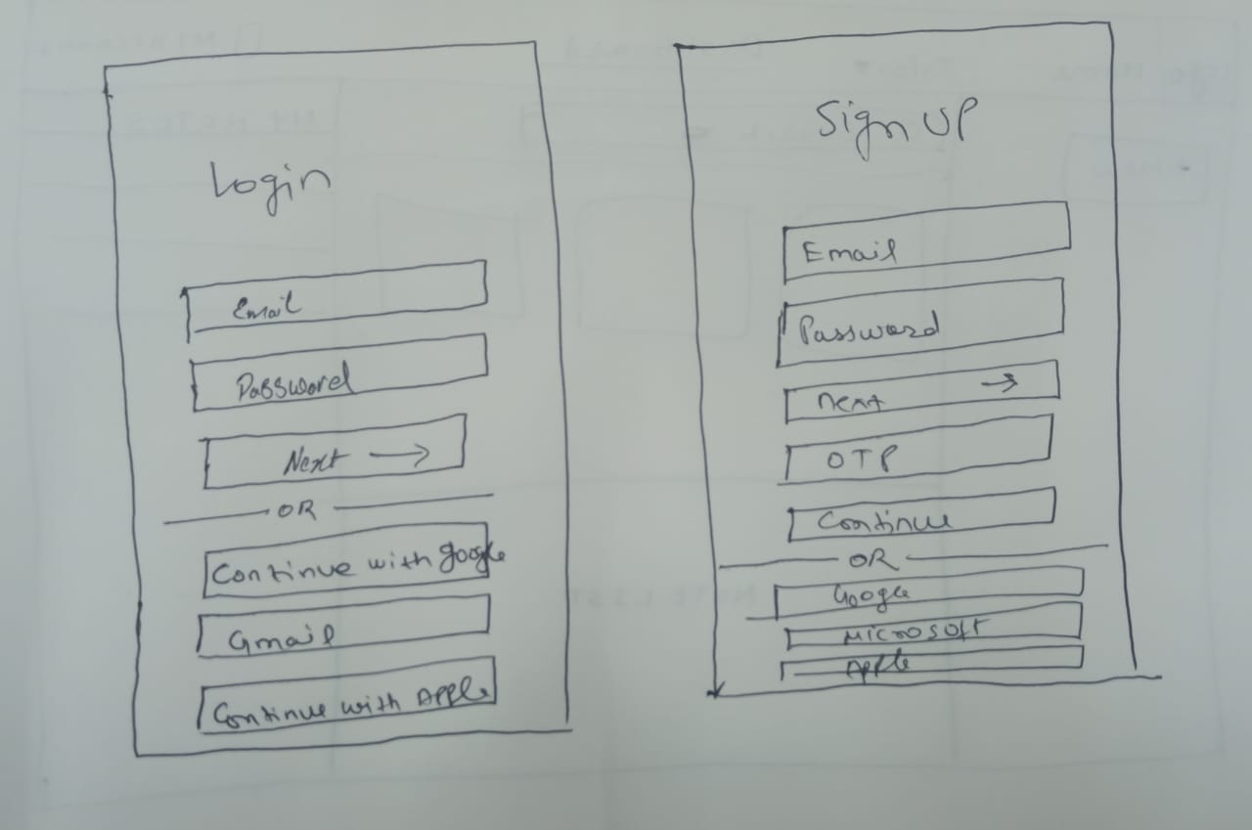
Layout

Slide 5
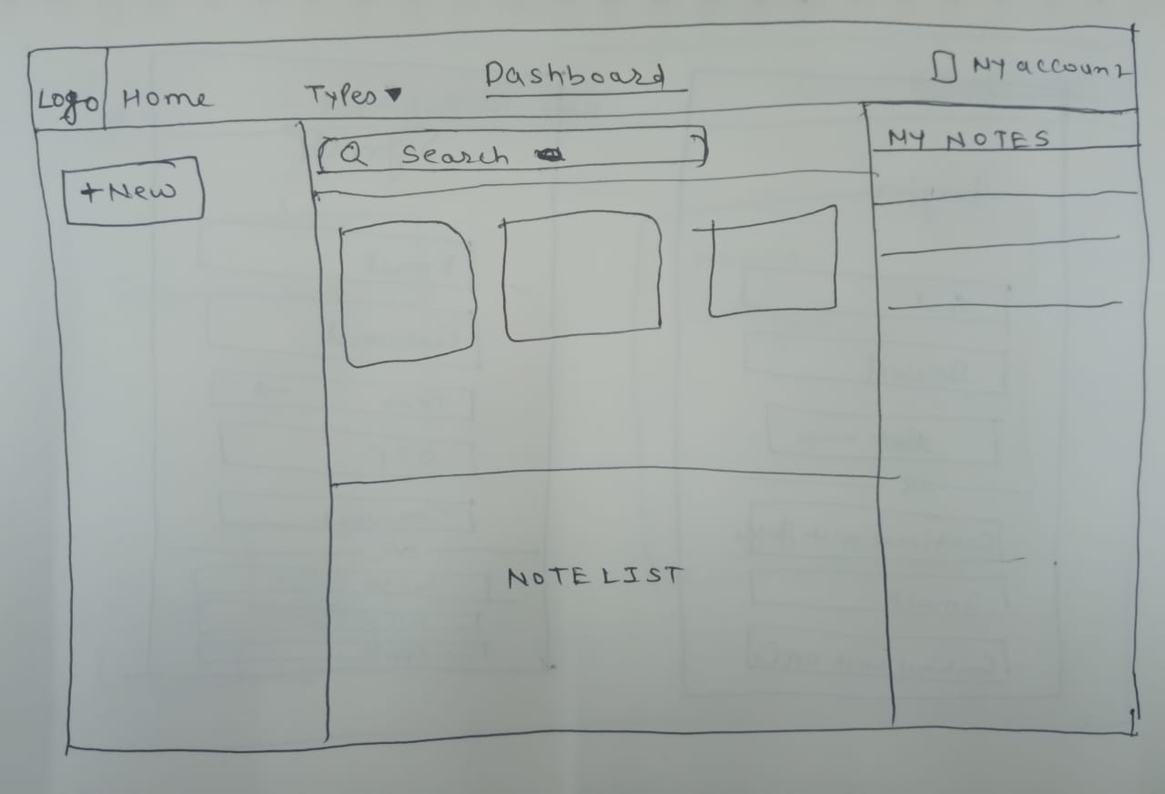
Layout

Slide 6
Details about component
Navigation Bar : To help the user to navigate through the pages or the different section of the web page.
Hyperlink: A hyperlink is a clickable element in the digital document. It is used to for moving to the page related to the hyperlink word.
Dashboard: It is user interface feature the provides the virtual representation of the activities and the history of the user.
Search: For finding the notes related to the similar words
Dropdown: It is the feature which provides the types of notes in drop down menu to select the type of notes you want to create

Slide 7


